Slide 1

Struktur Data
Recursion
Prepared by
Frans Panduwinata, S.Kom, M.T

Slide 2

Introduction
Recursion is the name for the case when a function invokes itself or invokes a sequence of other functions, one of which eventually invokes the first function again.
Every recursive process consists of two parts:
  A smallest, base case that is processed without recursion; and
  A general method that reduces a particular case to one or more of the smaller cases, thereby making progress toward eventually reducing the problem all the way to the base case.

Slide 3
Introduction (cont)
EXAMPLE:
  Suppose now that we have three functions called A, B, and C, and suppose that A invokes B and B invokes C.
  Then B will not have finished its work until C has finished and returned.
  Similarly, A is the first to start work, but it is the last to be finished, not until sometime after B has finished and returned.
  Thus nested function calls the sequence by which function activity proceeds is summed up as the property last in, first out.

Slide 4
Example: Factorial
In mathematics, the factorial function of a positive integer is usually defined by the formula
n! = n x (n-1) x … x 1
To calculate factorials, we need a more precise definition, such as the following:
1 if n = 0
n x (n-1)! If n > 0
{
n! =

Slide 5
Example: Factorial (cont)
EXAMPLE:
4! = 4 x 3!
= 4 x (3 x 2!)
= 4 x (3 x (2 x 1!))
= 4 x (3 x (2 x (1 x 0!)))
= 4 x (3 x (2 x (1 x 1)))
= 4 x (3 x (2 x 1))
= 4 x (3 x 2)
= 4 x 6
= 24
int factorial(int n)
{
if(n == 0)
return 1;
else
return n*factorial(n − 1);
}

Slide 6
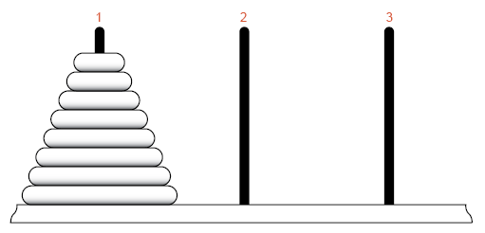
Example: Towers of Hanoi
Divide and Conquer:
To solve a problem, we split the work into smaller and smaller parts, each of which is easier to solve than the original problem.
The Towers of Hanoi:
move(64, 1, 3, 2) which means:
Move 64 disks from tower 1 to tower 3 using tower 2 as temporary storage.

Slide 7
Example: Towers of Hanoi (cont)
The recursive function that does the work is:
void move(int count, int start, int finish, int temp)
{
if (count > 0) {
move(count − 1, start, temp, finish);
cout << "Move disk " << count << " from " <<
start<< " to " << finish << "." << endl;
move(count − 1, temp, finish, start);
}
}

Slide 8
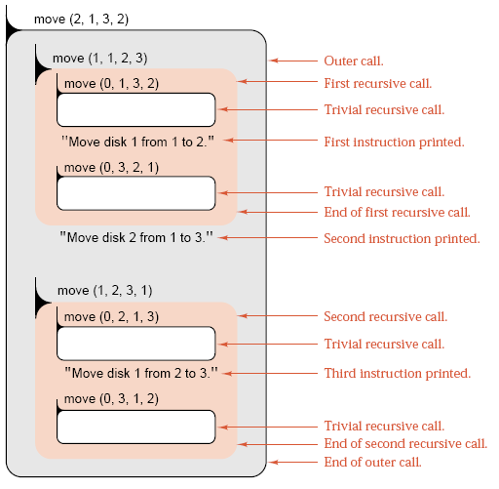
Example: Towers of Hanoi (cont)
Trace of Hanoi
for disks = 2
EXERCISE:
Trace the Towers of
Hanoi for disks = 4

Slide 9
When Not To Use Recursion
1. Factorials
Recursive
int factorial(int n)
{
if (n == 0)
return 1;
else
return n*factorial(n−1);
}
Iterative
int factorial(int n)
{
int count, product = 1;
for(count=1;count<=n;count++)
product *= count;
return product;
}
Which of these programs uses less storage space?

Slide 10

When Not To Use Recursion (cont)
At first glance, it might appear that the recursive one does, since it has no local variables, and the iterative program has two.
But actually (see the figure), the recursive program will set up a stack and fill it with the n numbers n,n − 1,n − 2, …, 2, 1 that are its calling parameters before each recursion.
Thus the recursive program keeps more storage
than the iterative version, and it will take more
time as well, since it must store and retrieve all
the numbers as well as multiply them.

Slide 11
When Not To Use Recursion (cont)
2. Fibonacci Numbers
A far more wasteful example than factorials is the computation of the Fibonacci numbers, which are defined by the recurrence relation
F0 = 0; F1 = 1; Fn = Fn−1 + Fn−2 for n >= 2.
The recursive program closely follows the definition:
int fibonacci(int n)
{
if (n <= 0) return 0;
else if (n == 1) return 1;
else return fibonacci(n − 1) + fibonacci(n − 2);
}

Slide 12
When Not To Use Recursion (cont)
As with factorials, we can produce a simple iterative program:
int fibonacci(int n)
{
int last_but_one, last_value, current; //Fi−2, Fi-1, Fi
if (n <= 0) return 0;
else if (n == 1) return 1;
else { last_but_one = 0;
last_value = 1;
for (int i = 2; i <= n; i++) {
current = last_but_one + last_value;
last_but_one = last_value;
last_value = current;
}
return current;
}
}

Slide 13
When Not To Use Recursion (cont)
The iterative function obviously uses time that increases linearly in n, so that the time difference between this function and the exponential time of the recursive function will be vast.

Slide 14
Fibonacci Vs Hanoi
The recursive function for Fibonacci numbers and the recursive procedure for the Towers of Hanoi have a very similar divide-and-conquer form.
Each consists essentially of two recursive calls to itself for cases slightly smaller than the original.
Why, then, is the Hanoi program as efficient as possible while the Fibonacci program is very inefficient?
The answer comes from considering the size of the output.

Slide 15
Fibonacci Vs Hanoi (cont)
In Fibonacci
  we are calculating only one number, and
  we wish to complete this calculation in only a few steps, as the iterative function does but the recursive one does not.
For Hanoi, on the other hand,
  the size of the output is the number of instructions to be printed, which increases exponentially with the number of disks.
  Hence any procedure for the Towers of Hanoi will necessarily require time that increases exponentially in the number of disks.

Slide 16
Exercises
The greatest common divisor (gcd) of two positive integers is
the largest integer that divides both of them. Thus, for example, the
gcd of 8 and 12 is 4, the gcd of 9 and 18 is 9, and the gcd of 16
and 25 is 1.
Write a nonrecursive function int gcd(int x, int y), where x and y are required to be positive integers, that searches through the positive integers until it finds the largest integer dividing both x and y.
Write a recursive function int gcd(int x, int y) that implements Euclid’s algorithm:
If y = 0, then the gcd of x and y is x;
otherwise the gcd of x and y is the same as the gcd of y and x%y.

Slide 17
Exercises (cont)
Rewrite the function in exercise number 2 into iterative form.
Discuss the advantages and disadvantages of each of these methods.

